Slide 1
Spring Training with Lunchtime Book Clubs
Audree Keele
TASL Conference 2014

Slide 2
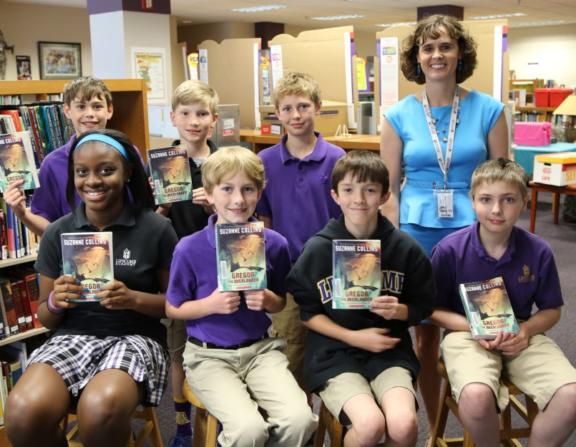
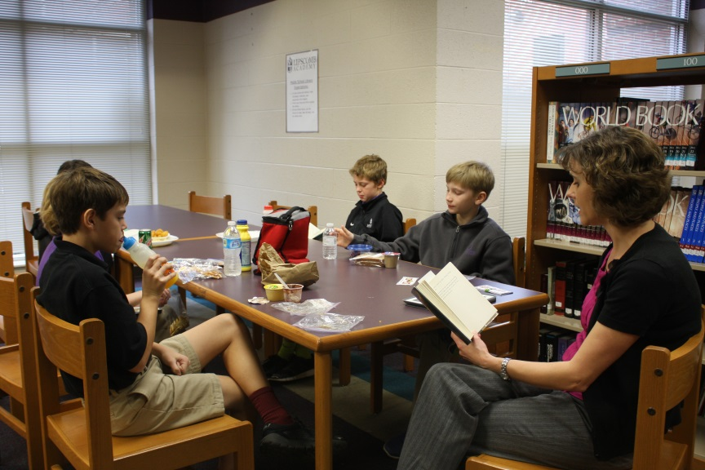
Lunch Bunch
Goals:
Increase reading practice time with support and accountability
Support comprehension with guided discussion
Increase fluency by following along with a fluent reader
Establish reading as a social activity with friends
Remove fear and dread from AR with quiz success

Slide 3
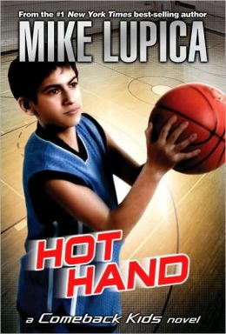
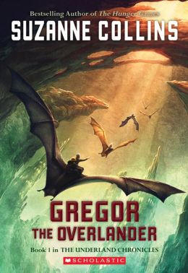
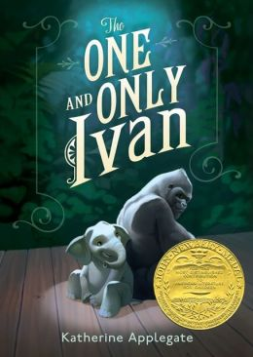
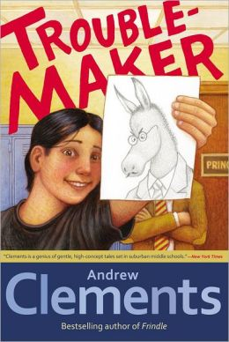
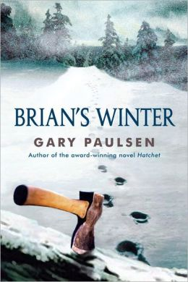
Lunch Bunch
When choosing books, I considered:
Age appropriate and quality materials
Reading level and length that set them up for success
Books they had not already been exposed to in elementary school
Short chapters
Availability of copies in library
Availability of inexpensive copies to purchase
Choice of students

Slide 4
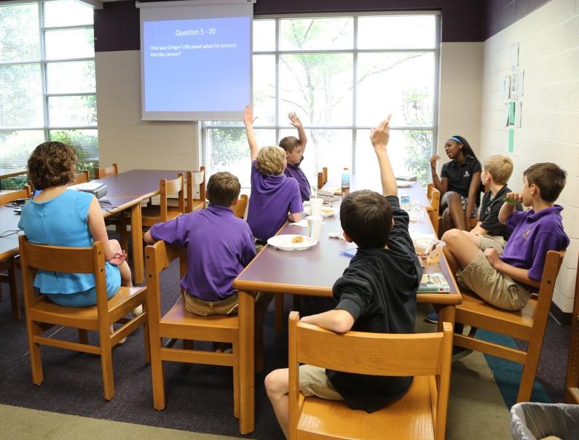
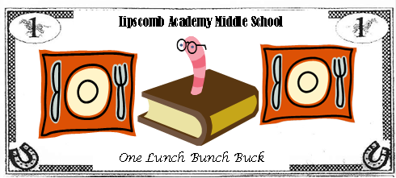
Lunch Bunch
Without grades for motivation, bribery is essential!
Lunch Bunch Jeopardy

Slide 5
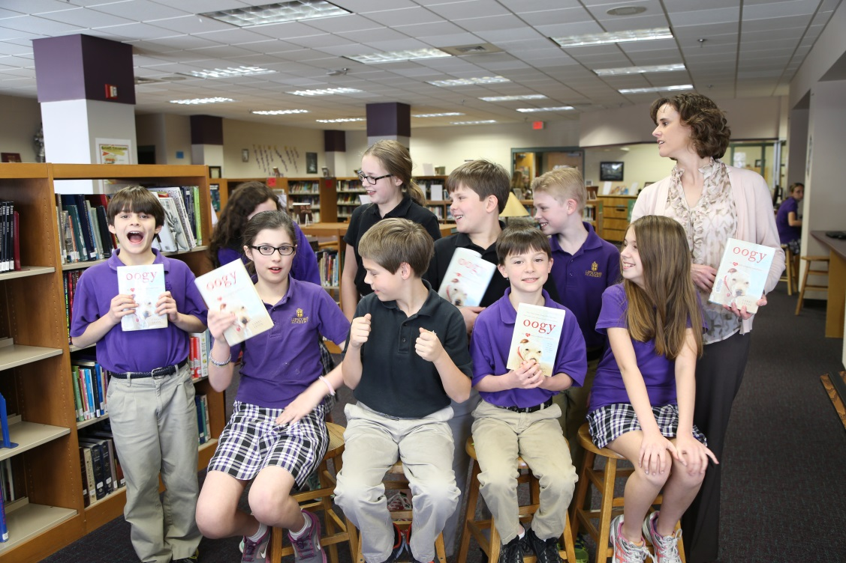
Book Club Cafe
Goals:
Enrichment for exceptionally strong readers through exposure to more advanced materials than those normally read in 5th grade
Development of a community of readers for discussing the big ideas found in literature

Slide 6
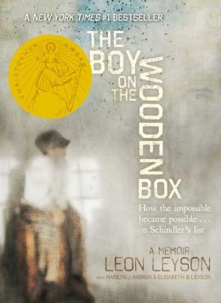
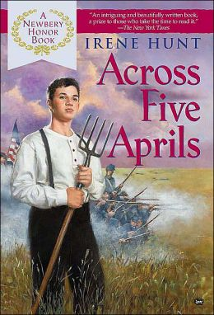
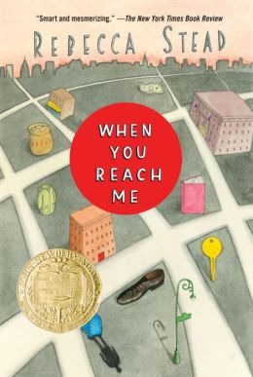
Book Club Cafe
When choosing books, I considered:
High reading level but 5th grade appropriate
Depth of ideas for discussion
Curriculum connections
Availability of copies in library
Availability of inexpensive copies to purchase
Choice of students

Slide 7
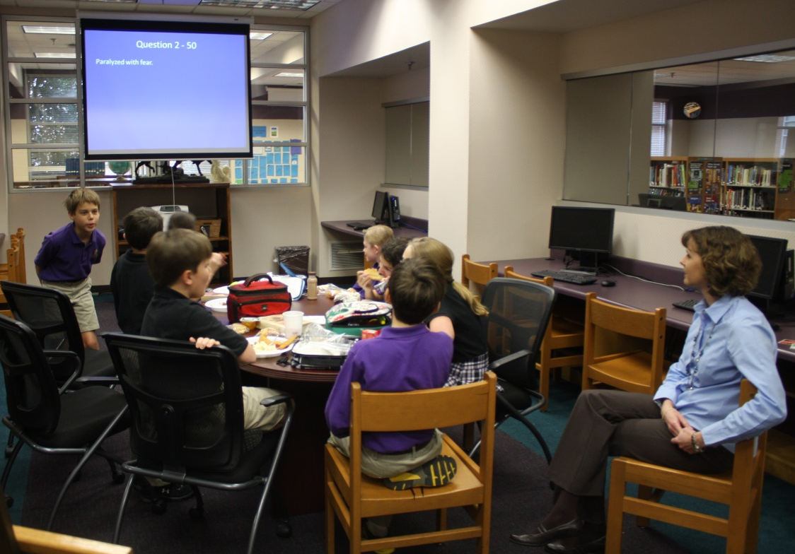
Book Club Cafe
Jeopardy was serious business in
Book Club Cafe

Slide 8
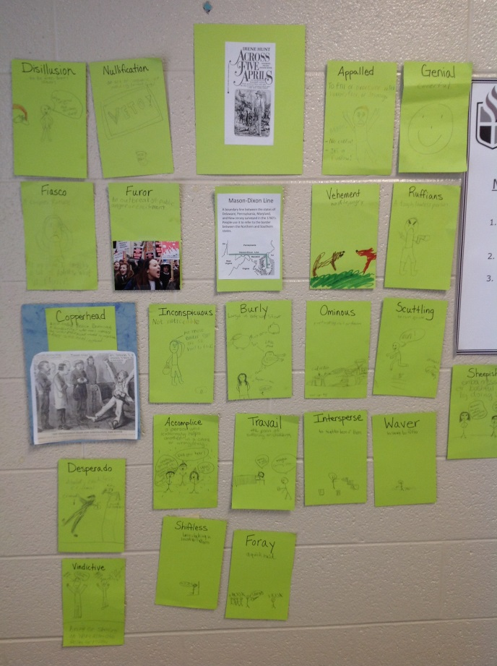
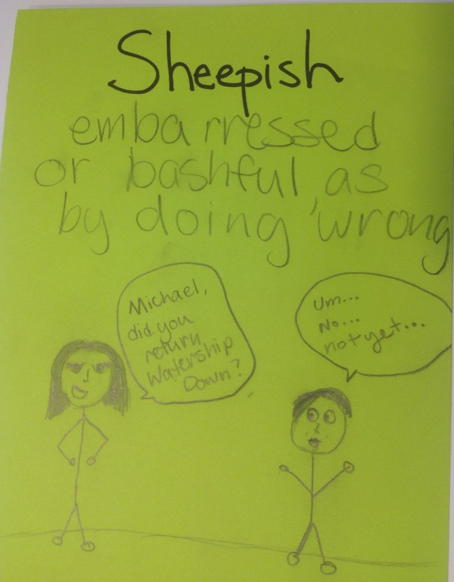
Book Club Cafe
My favorite Word Wall addition
Vocabulary Word Wall
(involving more bribery)

Slide 9
Book Club Café In Their Own Words
“My favorite part of Book Club Cafe was everything. The people, the books, the humor. Everything! I mean, really. What is not to love about Book Club Cafe??”
- Cassie
“My favorite thing about Book Club was being able to break the no eating or drinking rule in the library, just kidding. My favorite part about Book Club was the fact that all we could spend time talking about books we were reading.”
- Ethan

Slide 10
Book Club Café In Their Own Words
“My favorite thing about Book Club Cafe was that everyone had a chance to be part of the discussion. It wasn't like ‘man, I wish I could point this out, but I don't want to be disruptive’ and it wasn't like ‘wow, I really didn't understand this part, and everyone is talking about it, I feel so left out.’ It was just a group of friends talking about this book that they were reading, and discussing their thoughts. If anyone didn't understand, there was always someone to explain it, or if someone had made a connection to the story, there was always someone to listen.”
- Audrey

